Slide 1
Graph Database for Retrieval-Augmented Generation (RAG)
Arjun Bingly, Sanchit Vijay, Erika Pham, Kunal Inglunkar

Slide 2
Table of Content
Introduction
Retrieval-Augmented Generation (RAG)
Next Steps
Demo

Slide 3
Introduction
High-level idea: Create a package for a RAG pipeline that employs graph database instead of vector database

Slide 4
Retrieval-Augmented Generation (RAG)

Slide 5
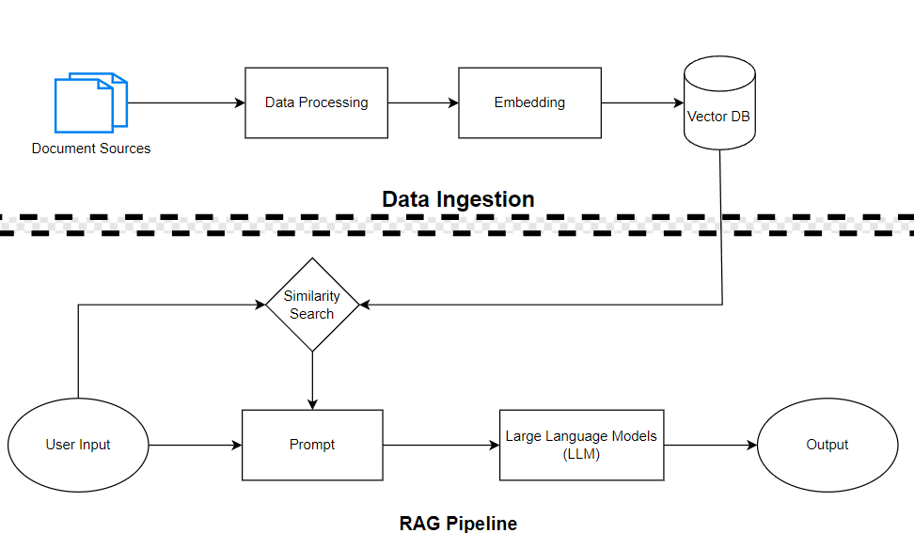
Pipeline

Slide 6
PDF Parser
Parsing PDF is challenging due to its unstructured nature
Tables and forms in particular are difficult due to its complicated layout
We make use of several open-sourced libraries as an attempt to improve this process:
Unstructured IO: partition_pdf() recognizes and parses a PDF file into different text, tables and images elements. Includes “FigureCaption”. Does well with text and images; has issues with tables
PDFPlumber: has decent layout detection and parses non-scanned tables well; but cannot parse scanned tables and images

Slide 7
Vector Database
Currently, package supports Chroma and Deeplake
Adding more support should be simple for users
Embeddings: uses instructor-xl, one of the best performing

Slide 8
Large Language Models (LLMs) Implementation
Cannot run un-quantize LLM with our computational resources -> use llama.cpp which provides quantization
Have text user interface (TUI) for users to easily download the model from HuggingFace and quantize
Tested our implementation with Llama2 7b & 13b, Mixtral 8x7b, Gemma 13b
Other compatible models include: GPT-2, Mamba, CodeShell, etc.

Slide 9
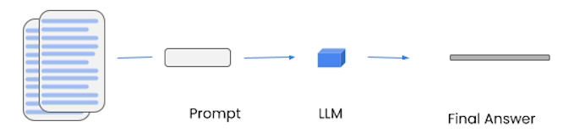
RAG Chains
Stuff Chain: Compiles and inputs all relevant information into the model in one go, efficient for small datasets but limited by the model's maximum context size.

Slide 10
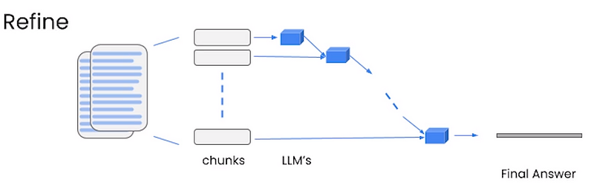
RAG Chains
Refine Chain: Iteratively processes each piece of information separately, refining the response over multiple steps, suitable for large datasets but more computationally intensive.

Slide 11
RAG Prompts
Uses model-specific prompts
For example, llama2 takes sys prompts:

Slide 12
RAG Prompts
"<s>[INST] <<SYS>>
You are a helpful, respectful and honest assistant.
Always answer based only on the provided context. If the question can not be answered from the provided context, just say that you don't know, don't try to make up an answer.
<</SYS>>
Use the following pieces of context to answer the question at the end:
{context}
Question: {question}
Helpful Answer: [/INST]"

Slide 13
Demo

Slide 14
Next Steps
Graph Implementation
GUI
PDF Parser: performance not consistent for all PDF files
Evaluation Suite: traditional RAG evaluation metric is not informative. Some alternative metrics require more computational power.

